Slide 1
Universal Acceptance –
Reaching CIOs in Government
Lars Steffen and Don Hollander
Report to the GAC @ ICANN61

Slide 2
Warm-Up

Slide 3
Warm-up Exercise
According to w3techs, which of the following pie charts most closely represents the fraction of websites on the Internet that are primarily English language based content?
25% English
75% All other
50% English
50% All other
75% English
25% All other
Actual data can be found at https://w3techs.com/technologies/history_overview/content_language/ms/y. Data shown is approximate.

Slide 4
Warm-up Exercise: Solution
According to w3techs, which of the following pie charts most closely represents the fraction of websites on the Internet that are primarily English language based content?
25% English
75% All other
50% English
50% All other
75% English
25% All other
Actual data can be found at https://w3techs.com/technologies/history_overview/content_language/ms/y. Data shown is approximate.

Slide 5
Warm-up Exercise
Each of the 3 groups below contain lists of Top Level Domains (TLDs) that are valid (approved and delegated by ICANN), except that each list contains one made-up or invalid TLD. Which TLD in each group is invalid?
Group A
Group B
Group C
嘉里
ANALYTICS
BLOCKBUSTER
DIAMONDS
HOTELES
广东
MOVISTAR
இந்தியா
REALLY
政务
ABC
مصر
ATHLETA
இலங்கை
CANCERRESEARCH
CITIC
新加坡
ESURANCE
FAKE
ไทย
GMAIL
قطر
JOY
LIKE
հայ
ONYOURSIDE
OOO
فلسطين
SILLY
SUCKS

Slide 6
Warm-up Exercise
The 3 invalid TLDs are highlighted below in red. There are 1541 valid TLDs (as of January 2nd, 2018), and the list is continuing to grow.
Group A
Group B
Group C
嘉里
ANALYTICS
BLOCKBUSTER
DIAMONDS
HOTELES
广东
MOVISTAR
இந்தியா
REALLY
政务
ABC
مصر
ATHLETA
இலங்கை
CANCERRESEARCH
CITIC
新加坡
ESURANCE
FAKE
ไทย
GMAIL
قطر
JOY
LIKE
հայ
ONYOURSIDE
OOO
فلسطين
SILLY
SUCKS

Slide 7
Building Blocks: gTLDs
Starting in 2013, ICANN (the organization responsible for the creation and maintenance of TLD assignments) approved the creation of a large number of new TLDs. These new TLDs can represent brands, communities of interest, geographic communities (cities, regions) and more generic concepts. Collectively, all of these new TLDs are known as Generic Top Level Domains (gTLDs).
Original Seven gTLDs
.com
.org
.gov
.edu
.mil
.net
.int
Common cc TLDs
.de
.cn
.uk
.nl
.eu
.ru
.tk
New gTLDs
.top
.xyz
.loan
.club
.网址
.信息
.コム

Slide 8
The Reality

Slide 9
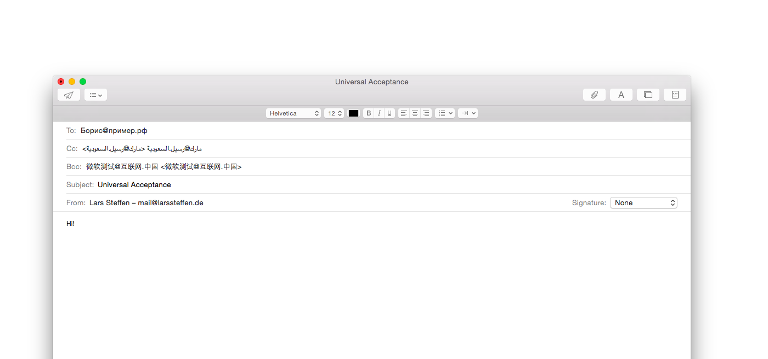

Slide 10
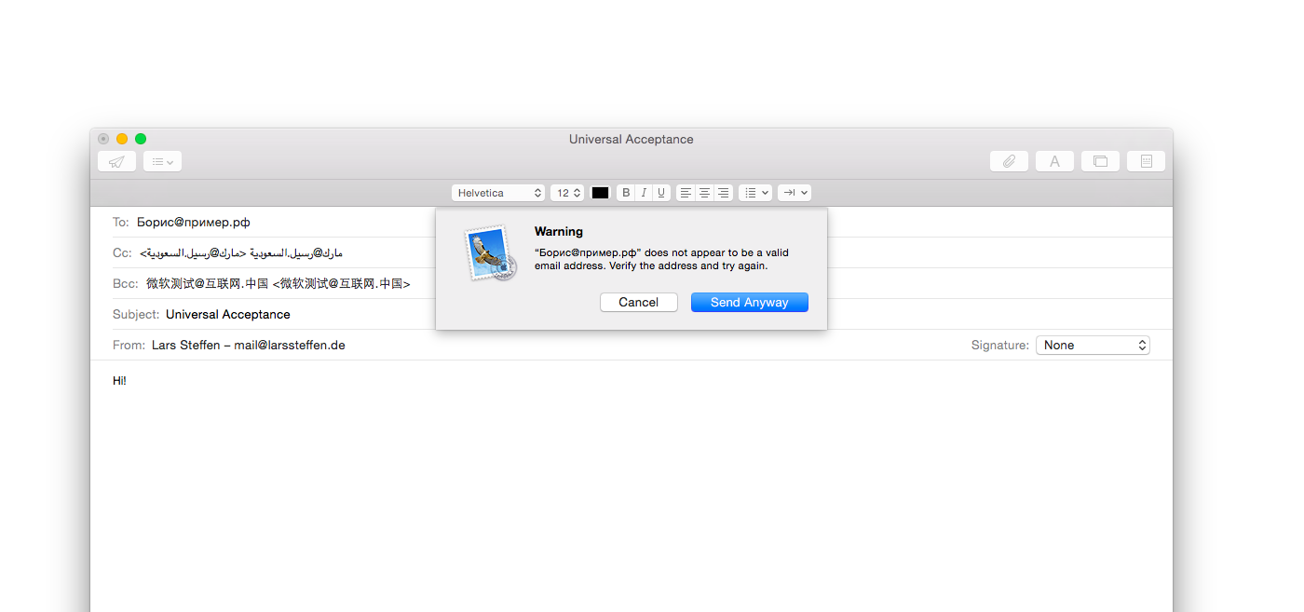

Slide 11
Definition
Universal Acceptance (UA) ensures that all domain names and email addresses can be used by all Internet-enabled applications, devices and systems.

Slide 12
Universal Acceptance Steering Group

Slide 13












Who is involved…

Slide 14
UASG Activities
Review Popular Websites, Dev Frameworks, Browsers, OS
Build Use Cases, Test Environments, EAI Community
Outreach Live Workshops, Panel Discussions, Presentations
Writing Knowledge Databases, Whitepapers, Quick Guides

Slide 15
Why should you care?

Slide 16
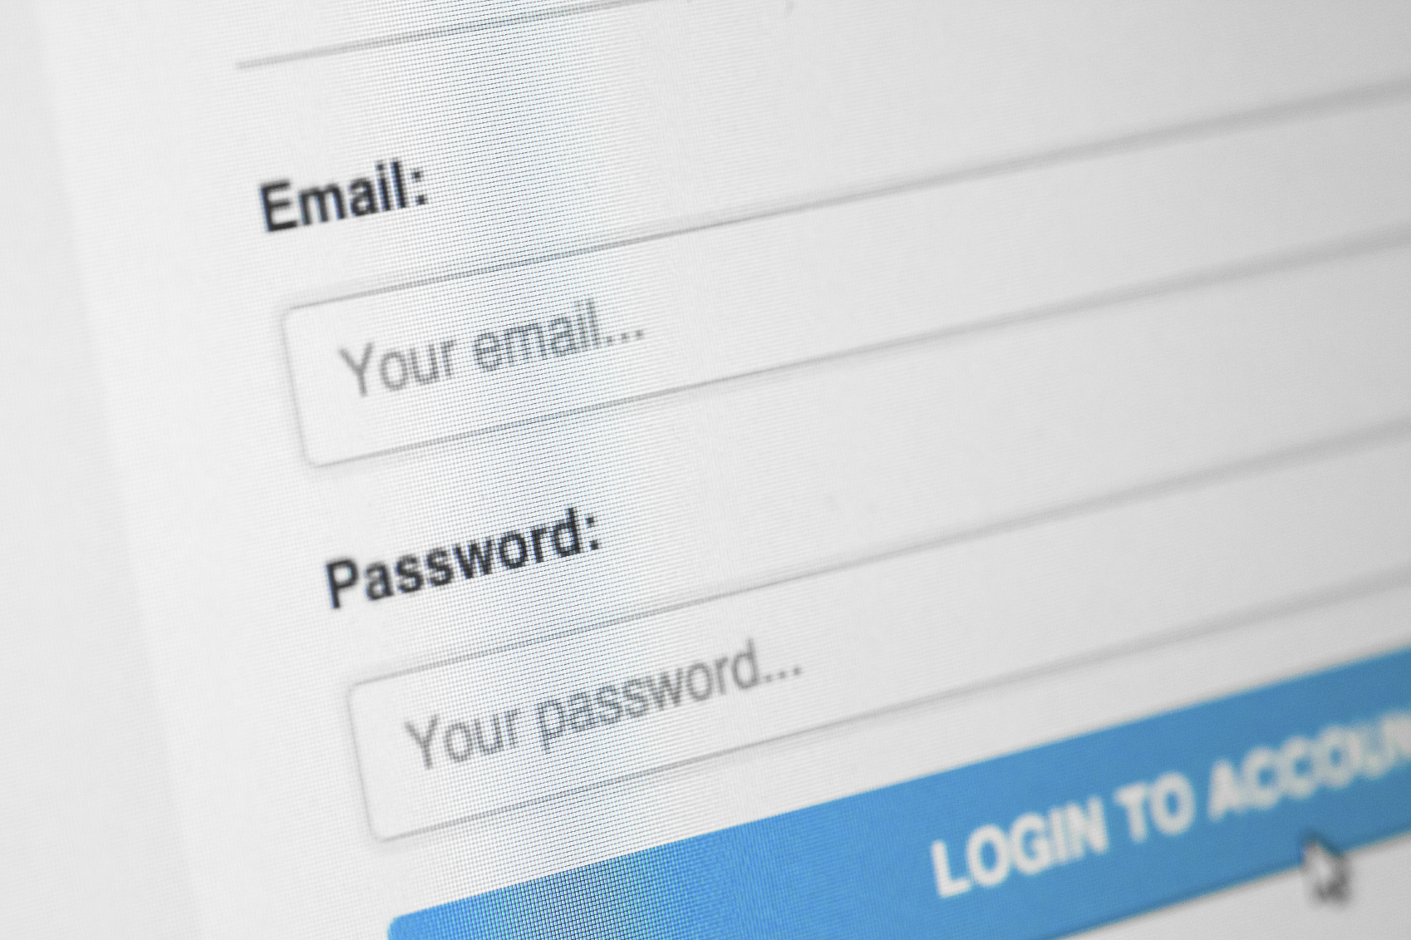

Slide 17
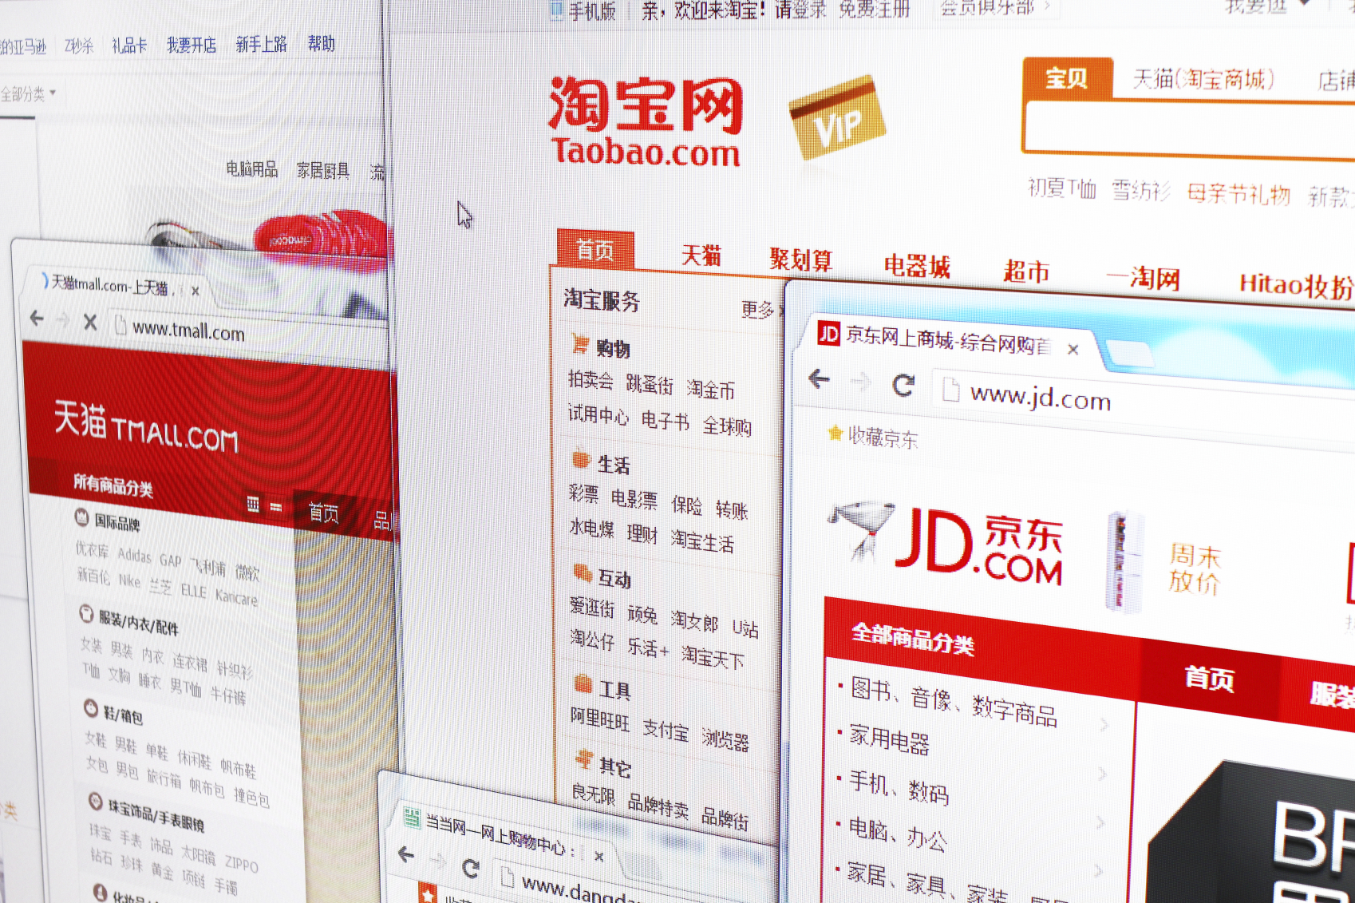

Slide 18


Slide 19
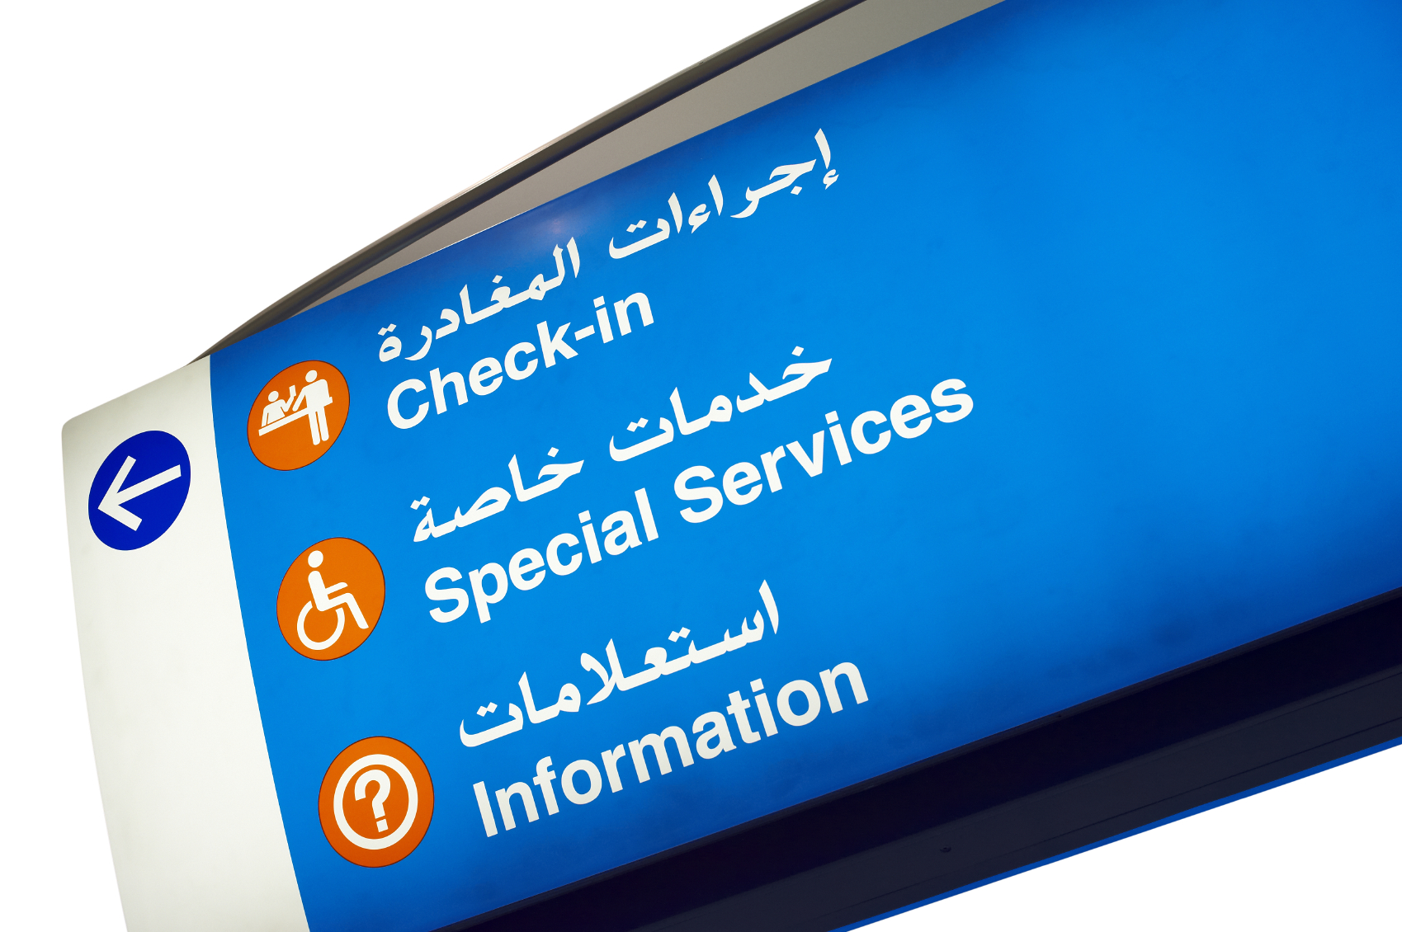

Slide 20
How Governments Can Help

Slide 21
How members of the GAC can help
Introduce the idea to CIOs in Government Organisations
  National, Provincial, Local
Introduce the UASG to CIOs in Government Organisations
Introduce the UASG to Professional Associations in your communities.
  Point them to www.uasg.tech
  Introduce them to info@uasg.tech

Slide 22

Further information
Visit uasg.tech
Visit bit.ly/icannUA
Visit github.com/icann
Get your Universal Acceptance Quick Guide!

Slide 24
How to get
Universal Acceptance ready?

Slide 25

Universal Acceptance ready
  Accept, Support, Use and Show Unicode.
  Store Information in UTF-8.
  Accept Strings up to 256 characters.
  Validate as little as possible.
    Verify TLDs against authoritative table.
    Query domain name against DNS.

Slide 26
Universal Acceptance ready
  When developing app / service, or operating a registry, consider languages supported.
  Perform code reviews.
  Check code points that were not defined when application / service was created.

Slide 27
Universal Acceptance ready
  Consider mixed-script addresses become more common.
  Convert non-Unicode to Unicode before display.
  Use Unicode IDNA Compatibility Processing
  to match user expectations.
  End user should see “everyone.みんな” vs. “everyone.xn--q9jyb4c.”

Slide 28
Some technical information

Slide 29
Building Blocks: ASCII and Unicode
A character mapping associates characters with specific numbers. Many different code pages have been created over time for different purposes, but for this topic we will focus on only two: ASCII and Unicode.
ASCII
Unicode
Most of the text currently displayed on the internet is in the Latin character set. This character set is included in the American Standard Code for Information Interchange (ASCII, or US-ASCII) character-encoding scheme. ASCII is an older encoding scheme and was based on the English language. For historical reasons, it became the standard character encoding scheme on the Internet.
Because most writing systems do not use the Latin character set, alternate encodings have also been adopted. The most common form of Unicode is called Universal Coded Character Set Transform Format 8-bit (UTF-8).
To see all Unicode character code charts, go to: http://unicode.org/charts

Slide 30
Building Blocks: ASCII and Unicode (cont.)
ASCII
Unicode
ASCII uses only 7 bits per character, which limits the set to 128 characters, not all of which can be used in domain names.
Domain names are limited to the characters A-Z, the numbers 0-9, and hyphen “-“.
Unicode, also known as the Universal Coded Character Set (UCS), is capable of encoding more than 1 million characters.
Each of these Unicode characters is a called a code point.

Slide 31
Building Blocks – Internationalized Domain Names and Email Addresses
The use of Unicode enables domain names and email addresses to contain non-ASCII characters.
  Domain names that use non-ASCII characters are called Internationalized Domain Names (IDNs). The internationalized portion of a domain name can be in any level – not just the TLD but also the other labels.
  Email addresses that use non-ASCII characters are called Internationalized Email Addresses. The internationalized portion can be at the local or domain part of the address.
Since the DNS itself previously only used ASCII, it was necessary to create an additional encoding to allow non-ASCII Unicode code points to be converted into ASCII strings, and vice versa.

Slide 32
EAI, examples
Left to Right (LTR) Scripts
user@example.app
Right to Left (RTL) Scripts
app. مثال@المستخدم
Username
Domain
TLD
TLD
Domain
Username
More Examples of (imaginary) Email Addresses including IDNs
user@example.みんな (Uses internationalized TLD)
user@大坂.info (Uses internationalized 2nd level domain)
用戶@example.lawyer (Uses internationalized user name and new gTLD)

Slide 33
POP & IMAP Servers
Post Office Protocol version 3 (POP3) supports international strings encoded in UTF-8 in usernames, passwords, mail addresses, message headers, and protocol-level text strings (see RFC 6856).
Internet Message Access Protocol (IMAP) supports UTF-8 encoded international characters in user names, mail addresses, and message headers (see RFC 6855).

Slide 34
Items for Email Service Providers to Consider
Don’t enforce case-sensitivity of local-part mailbox names.
Allow the user to enter the email address in any combination of upper-and-lowercase characters so long as the script is correct.
Don’t issue mailbox names which will duplicate other mailbox names which have the same characters but different cases (e.g. “user@example.TLD”) and “uSer@example.tld”).
Note non-ASCII case folding may not work because it is language specific.

Slide 35
Items for Email Service Providers to Consider
Offer an all-ASCII mailbox name to the user when they are issued an EAI-compatible mailbox name.
  If both names alias to the same mailbox (i.e. can be used interchangeably) users will find it easier to initially share addresses with other users who use a different script.
  Once the ASCII address is initially shared, a user can decide whether to also add the EAI-compatible address to their address book.

Slide 36
Items for Email Service Providers to Consider
Offer mailbox names which conform to the domain name Label Generation Rules (LGR) for the selected script.
  Such names are guaranteed to be compatible with the Punycode algorithm.
  These email addresses can easily be shared by users with their friends and colleagues who do not use their same writing method; the colleague or friend can address email to such an address, or create an address book entry, using the A-label format.
  Upon use, the client MUA software should convert the A-Label to the appropriate U-Label, at which point the friend or colleague will possess the EAI formatted email address despite not having a keyboard or IME which supports the target script.

Slide 37
Encountering UA issues? uasg.tech/global-support-centre

Slide 38
Thank you!

